Slide 1
RIDING AND THE ALEXANDER TECHNIQUE
How can the Alexander Technique help improve horse riding skills?
It’s not about posture!
Notes:
What use is the Alexander Technique to people who can already ride? Riding is about feel. Similarly, the Alexander Technique lesson is where you will learn how to use yourself differently. To attempt to describe the Technique to anyone is like trying to describe the colour red to a person blind from birth. Understanding something does not always mean understanding intellectually. It is embodied learning, like riding. Your body and mind learn a new skill. How does this help with riding?

Slide 2
How does it help with riding?
Notes:
When you train your horse what are you aiming for? Outline?
You would like your horse to drop at the poll and lead with the head so that his hindquarters can engage and therefore ‘carry’ himself and the rider is a better way. This is done through a process of schooling which leads to strengthening a set of muscles so that this can be achieved. He learns to use himself differently.
Similarly, in an Alexander Technique lesson, the pupil will use my hands and my voice to help you train you to use yourself differently, with the head leading the movement and proper engagement of the whole body.
After a period of lessons (schooling) you get to feel this new way of going in yourself. This is combined with releasing unnecessary tensions and pullings which

Slide 3
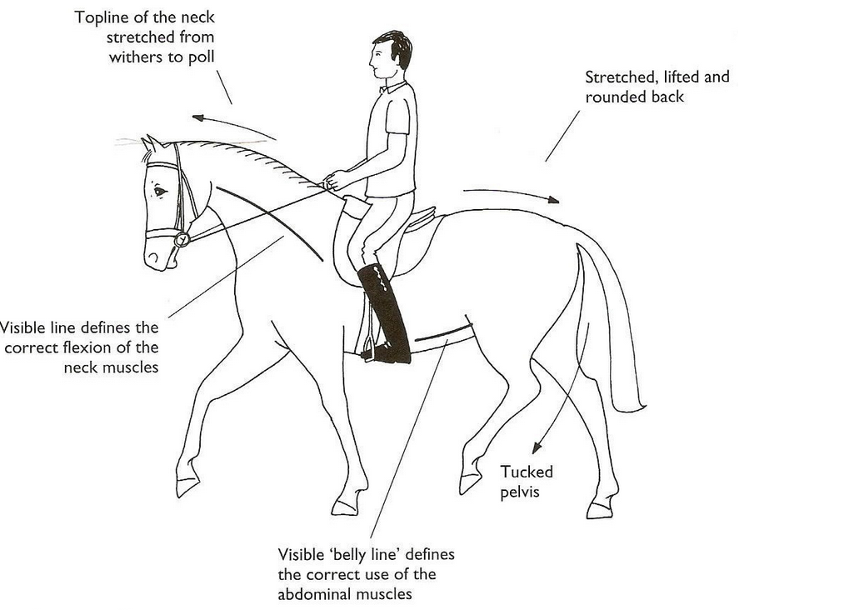
FORM NOT OUTLINE; USE NOT POSTURE
Notes:
When you train your horse what are you aiming for? Outline?
You would like your horse to drop at the poll and lead with the head so that his hindquarters can engage and therefore ‘carry’ himself and the rider is a better way. This is done through a process of schooling which leads to strengthening a set of muscles so that this can be achieved. He learns to use himself differently.
Similarly, in an Alexander Technique lesson, the pupil will use my hands and my voice to help you train you to use yourself differently, with the head leading the movement and proper engagement of the whole body.
After a period of lessons (schooling) you get to feel this new way of going in yourself. This is combined with releasing unnecessary tensions and pullings which

Slide 4
EMBODIED KNOWLEDGE IE ‘FEEL’
So during a lesson you will learn from my hands (aids), that you are habitually tensing yourself unnecessarily. I will enable you to see/feel your way of going by helping you to change the geography of your coordination, so that your mis use is emphasized and undone. Your contact becomes clearer in the process.
Notes:
You will learn how to use your mind to move
How your muscular habits can become more controlled so that your contact becomes clearer.
That your muscular habits are linked 100 per cent to your mental habits.

Slide 5
‘holding on’
You are already doing something to yourself which you cant feel.
This is because muscles always want to go the way they have always gone.
Ie; the sense of ‘rightness’ comes about through repetition but this doesn’t mean that its right just because it feels right.
We call this ‘Faulty sensory appreciation’.
Through ‘the work’ you will gain a different sense of yourself and realise how much you are holding on.

Slide 6
The ‘work’
Lessons can improve your contact.
You will become more aware of what you are doing with yourself.
You will ask from yourself that which you are asking from your horse; this embodied knowledge will give insight into your equine work, no matter which theories of riding you endorse.
You will improve your own use in the process and will connect this to your horse.You will ride with less tension.
All mammals lead movement with the head.This will mean changing your ‘way of going’.

Slide 7
WHAT IS A HUMAN?
Notes:
And……..a human is a mammal……

Slide 8
All mammals,including humans, lead movement with the head, for the best biomechanically efficient way of going.
Notes:
Just because we are bipedal, does not mean we are not mammals. All mammal lead movement with the head.

Slide 9
THE CHAIR
Notes:
Why we use the chair; give demonstration.

Slide 10
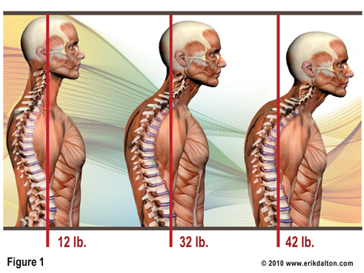
You will not learn anything new!
Notes:
It wont be like going to a yoga or pilates class to learn new moves or to condition your body.
You will over time unfold or reveal what you are doing now with your body which you don’t need to do. Bring out folded pillow case.
If you are not leading your movements with the head, then you are mis using yourself. Simple.

